Slide 1
Loyalty, dignity and hope: The Local Suffrage Movement
Milborne Port
Heritage and History Group
Monday 20th May 2019
Presented by: Lesley Wray, Janet Matthews, Mary Clothier, Lyn Harrison and
Nathalie Hetherington

Slide 2
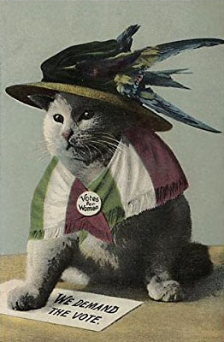

Slide 3
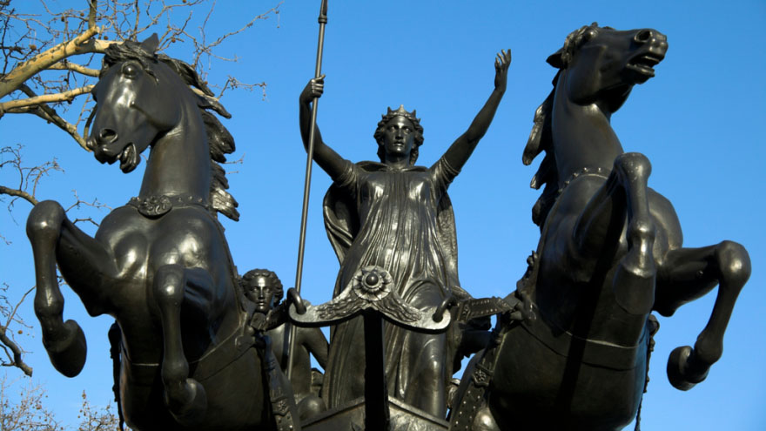

Slide 4
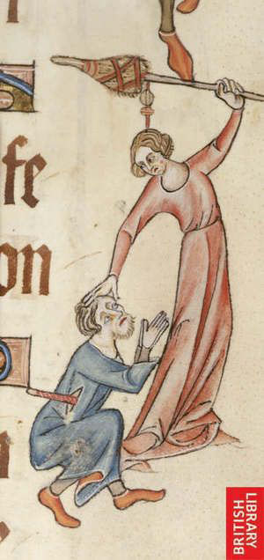

Slide 5
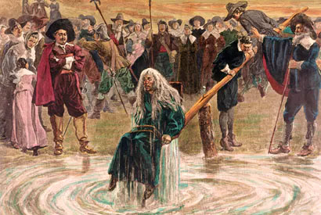

Slide 6
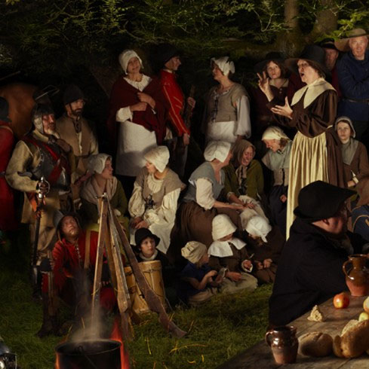

Slide 7
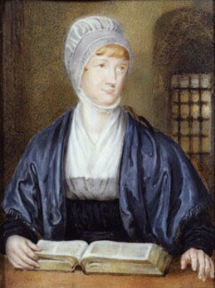

Slide 8
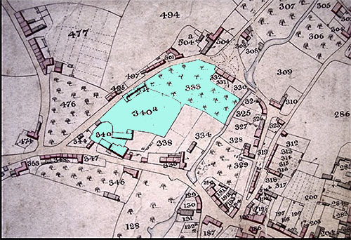
Mary Scott (1751/2?-1793)

Slide 9
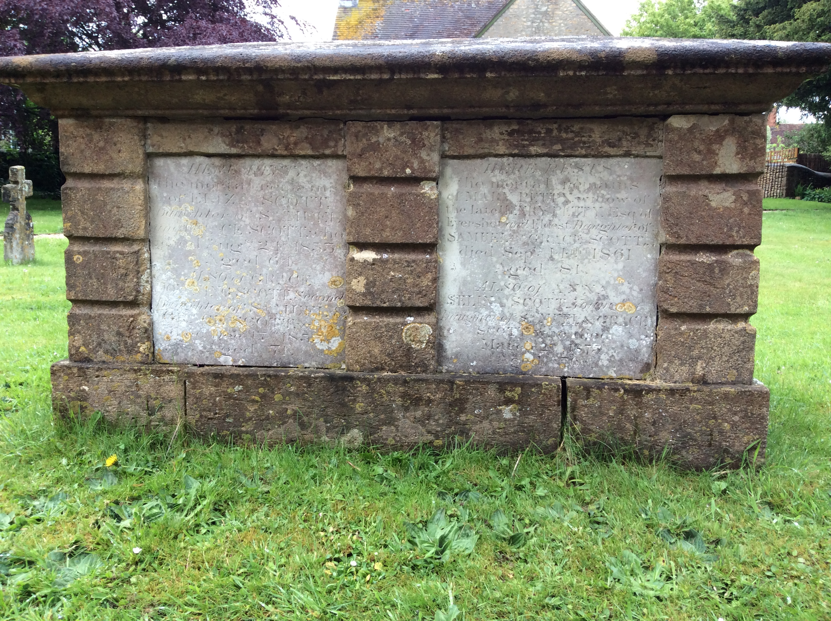

Slide 10
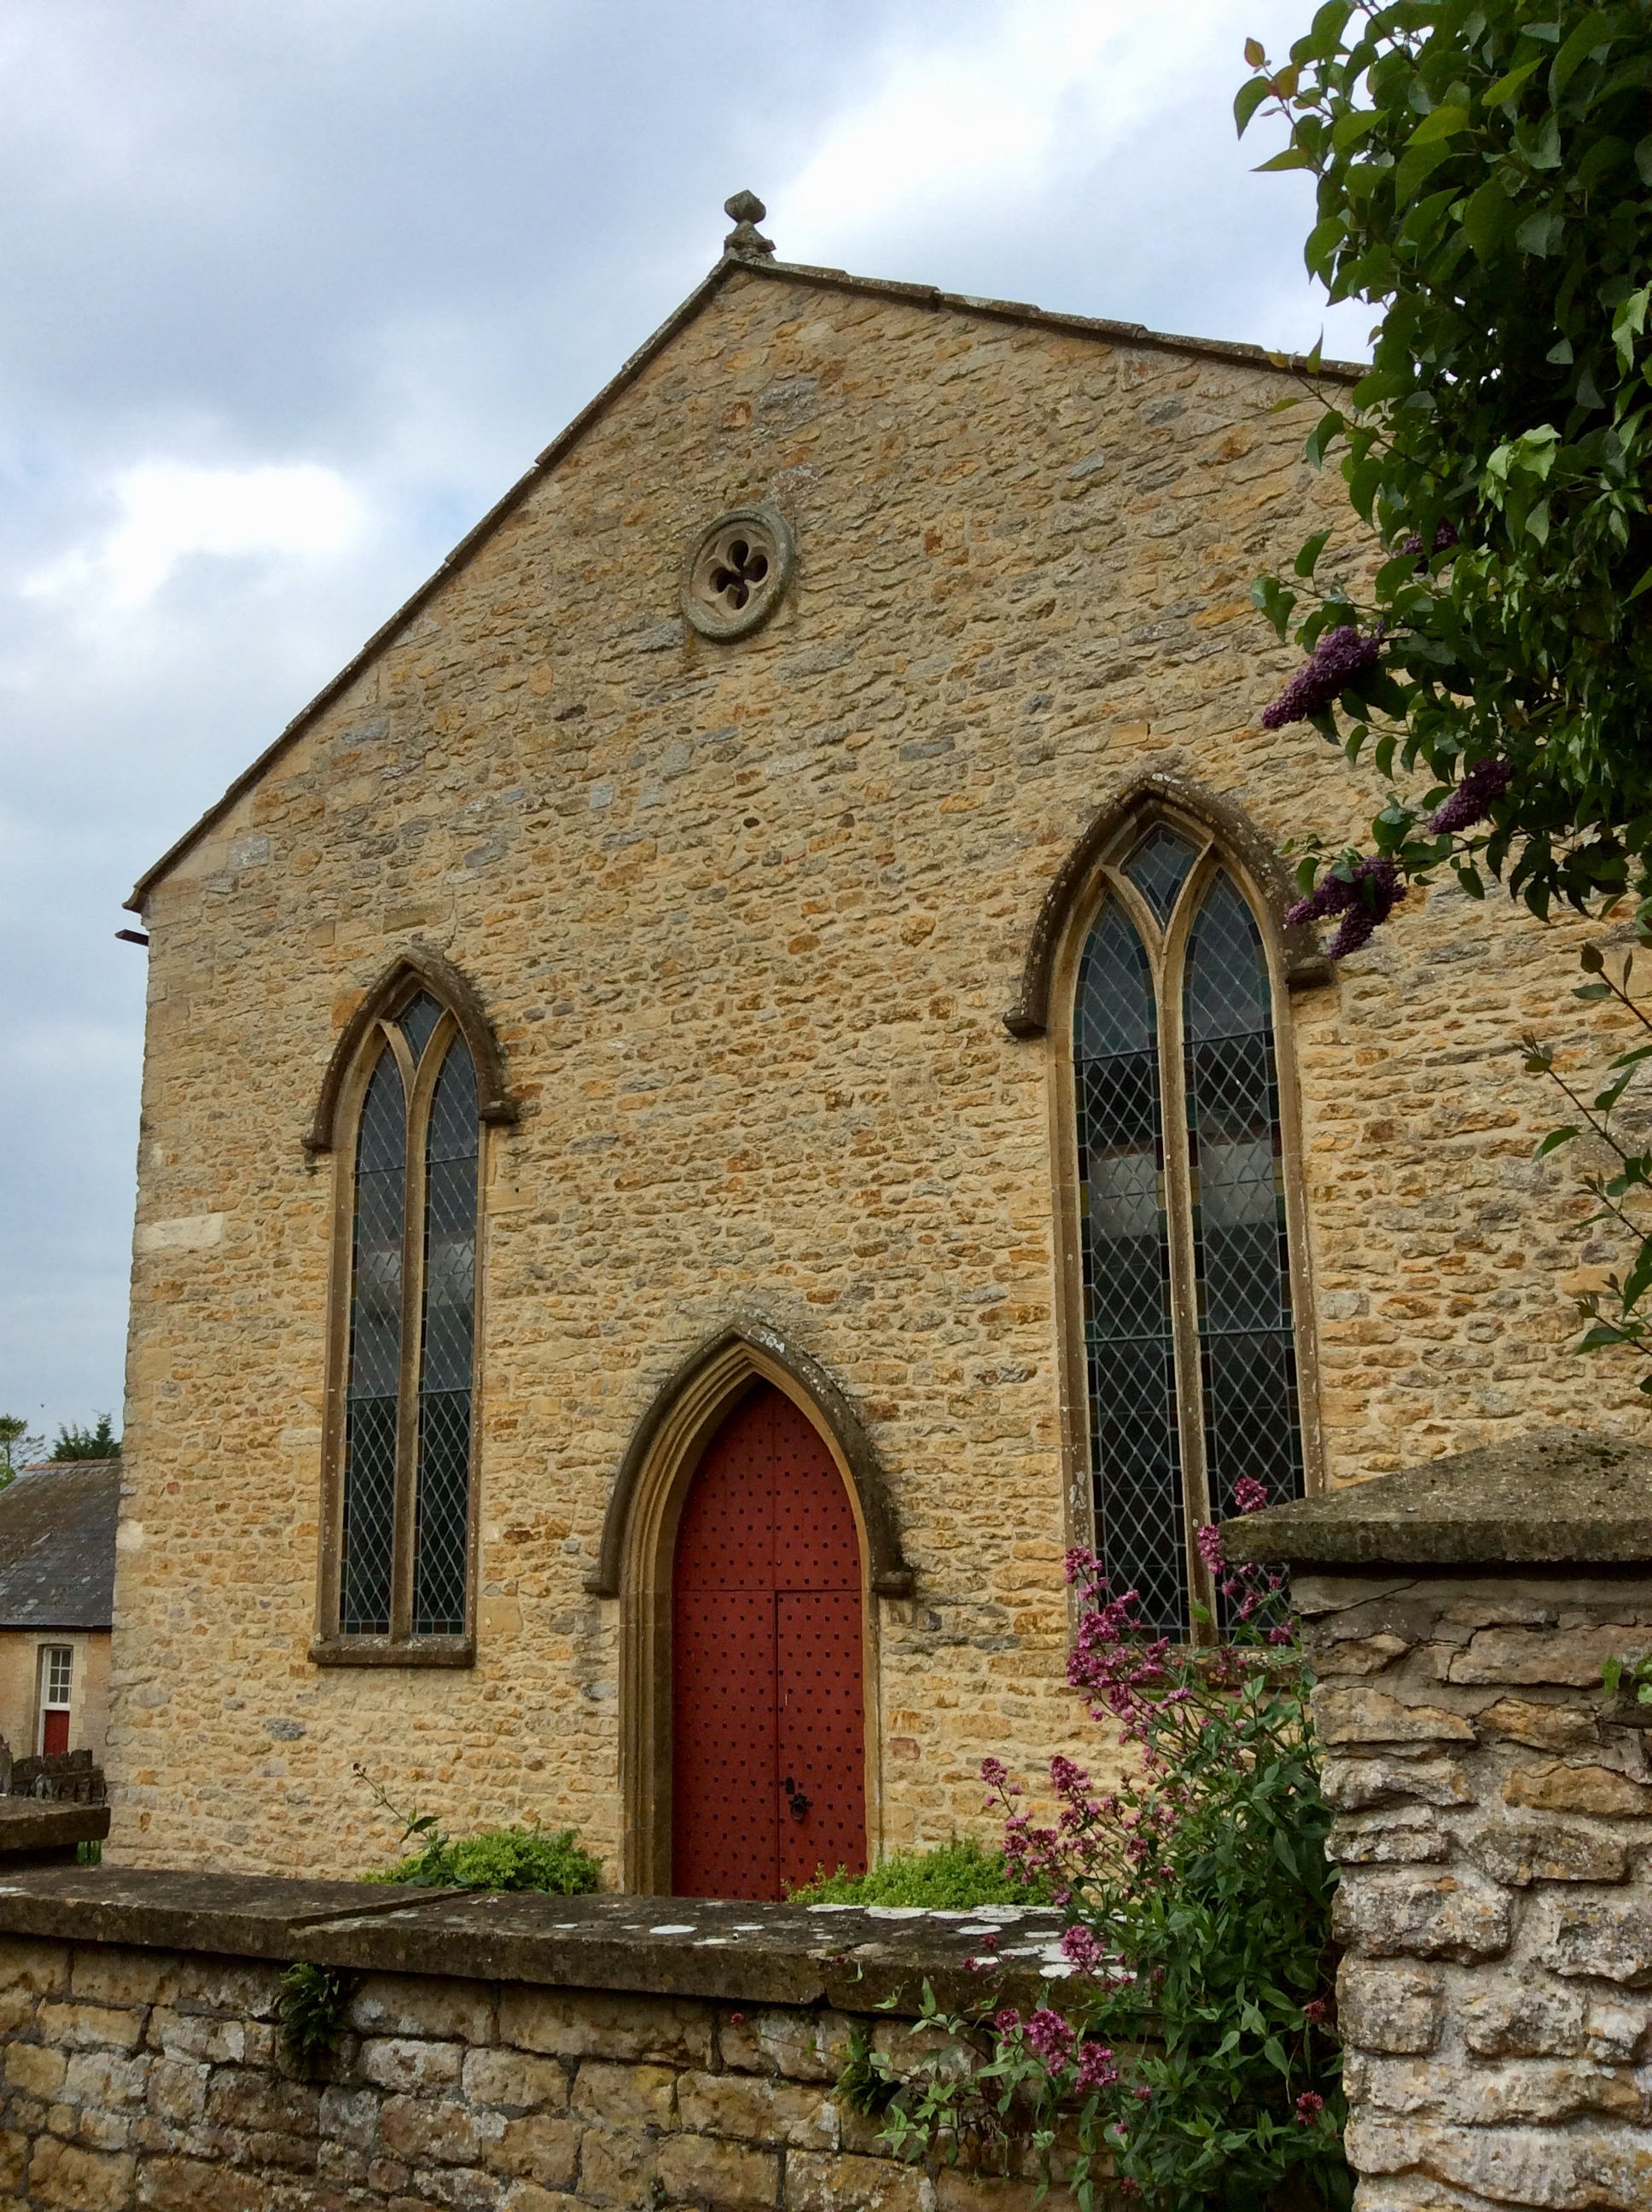
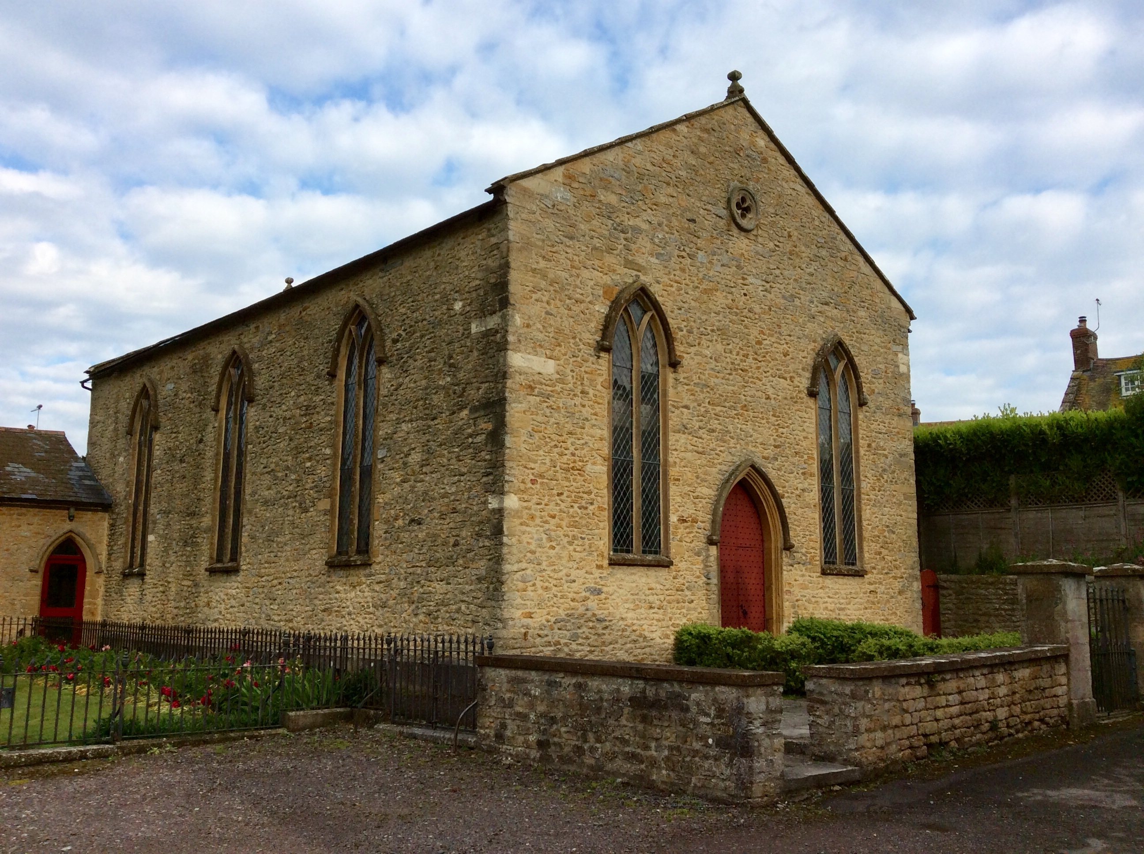
Congregational Church, then the Independent Meeting House, now the Organ Museum (Chapel Lane)

Slide 11
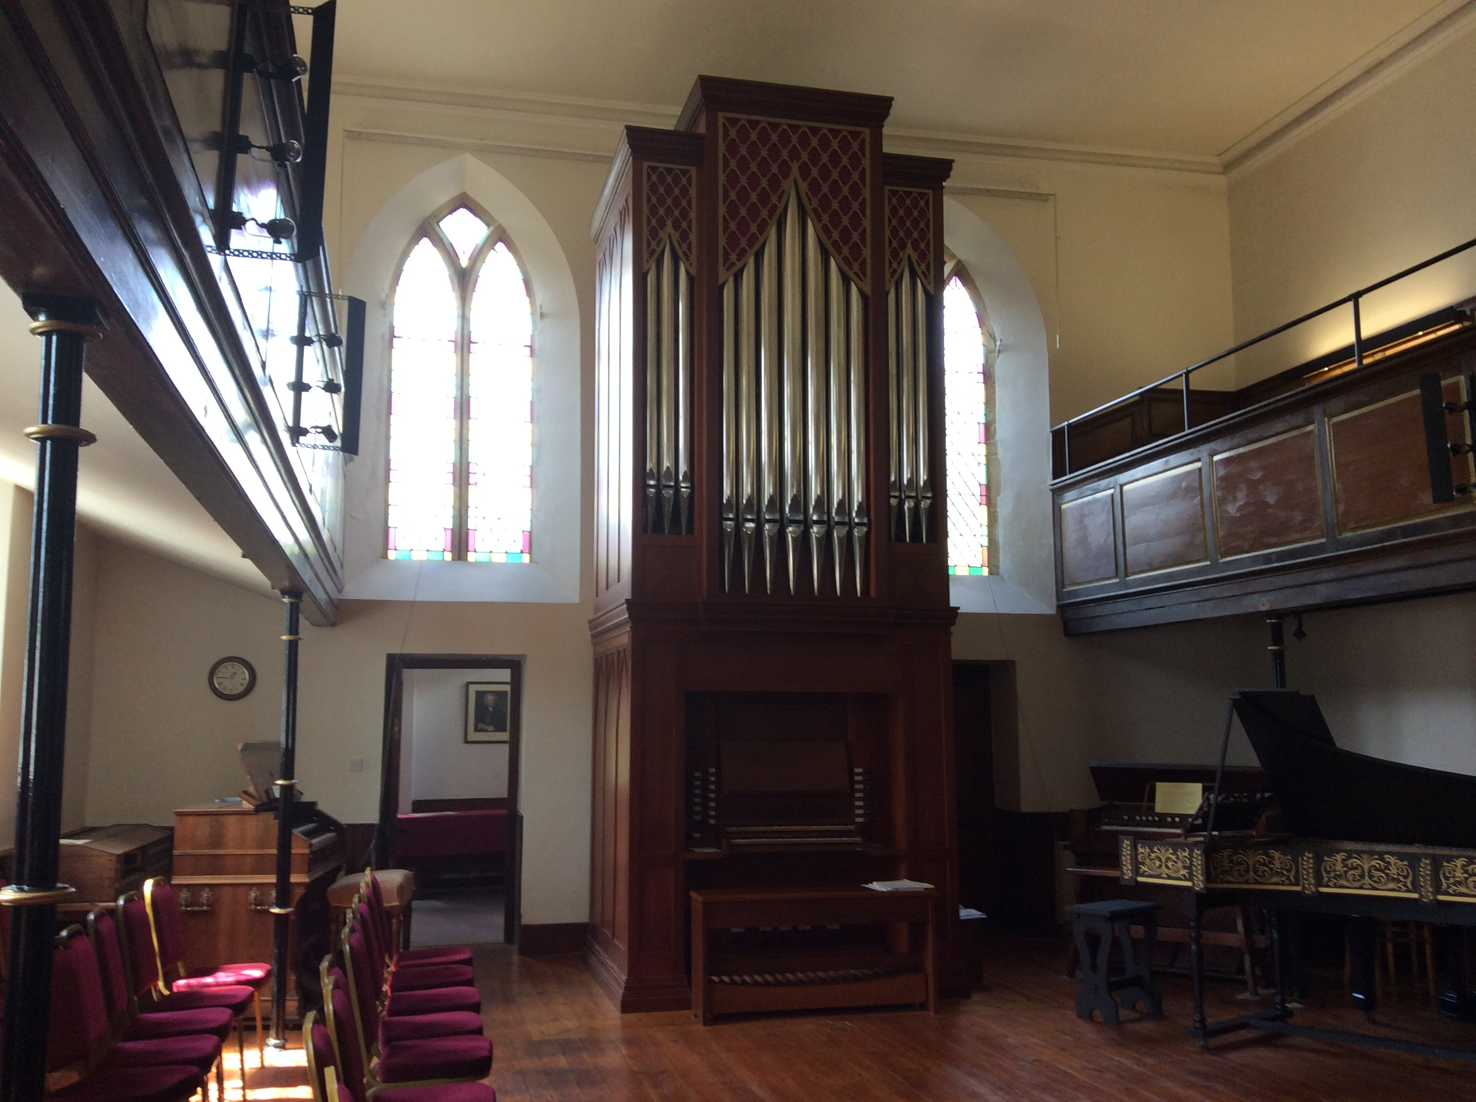

Slide 12
The Female Advocate – 1774

Slide 13
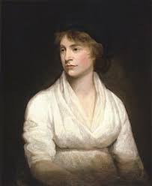
Mary Wollstonecraft (1759-1797)
‘A Vindication of the Rights of Women’ 1782
‘hyena in a petticoat’
(Horace Walpole)

Slide 14
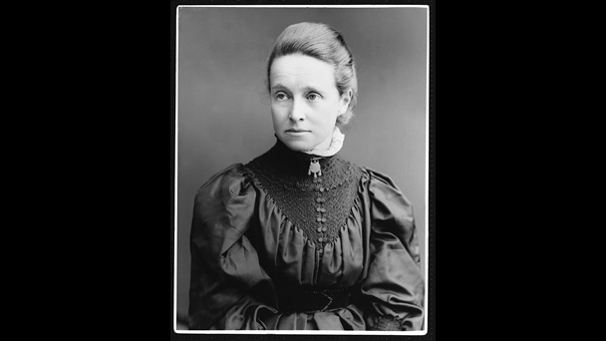
Suffragists
Millicent Fawcett
18.. To ..19..

Slide 15
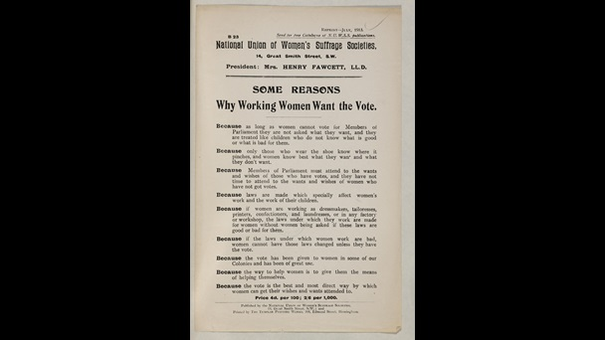
Suffragists
18.. To ..19..

Slide 16
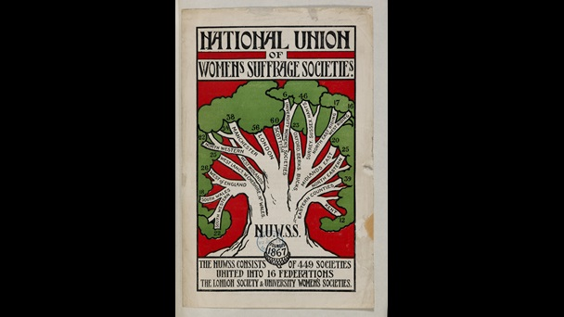

Slide 17
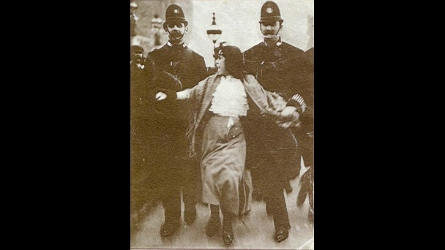
Dora Thewlis

Slide 18
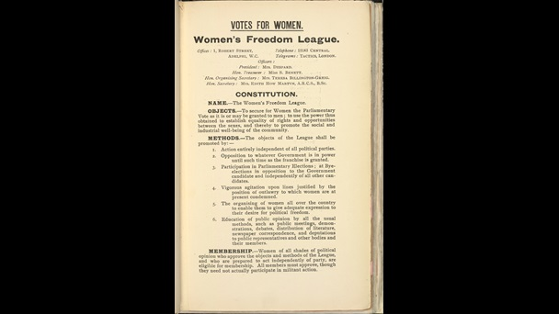
Dora Sulis

Slide 19
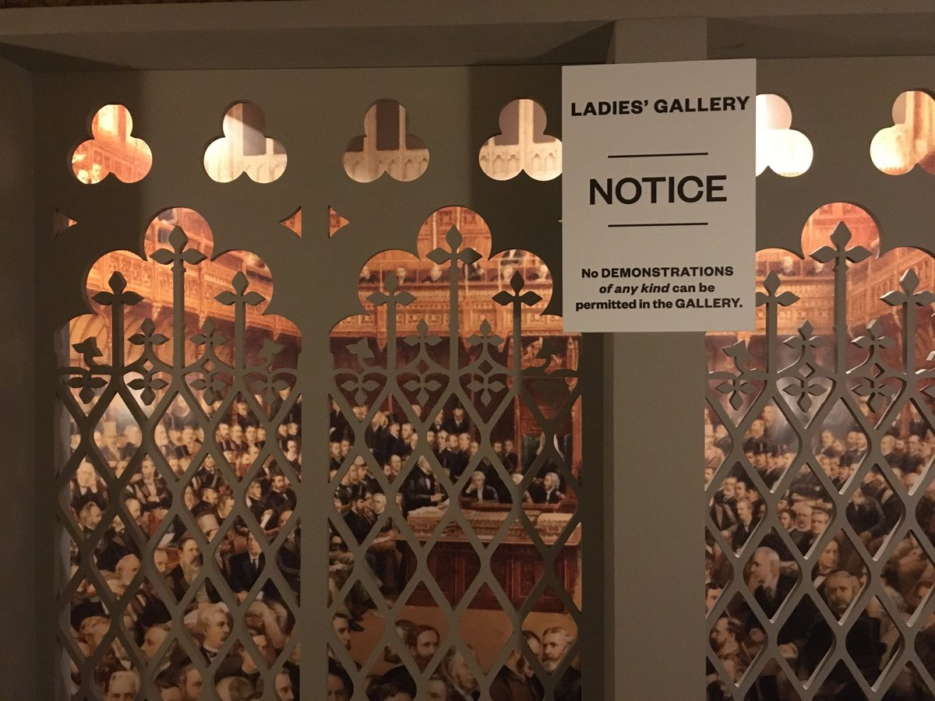
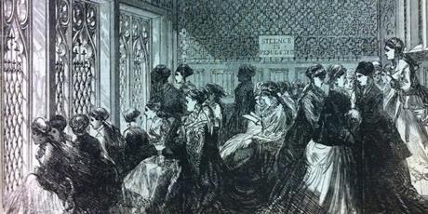

Slide 20
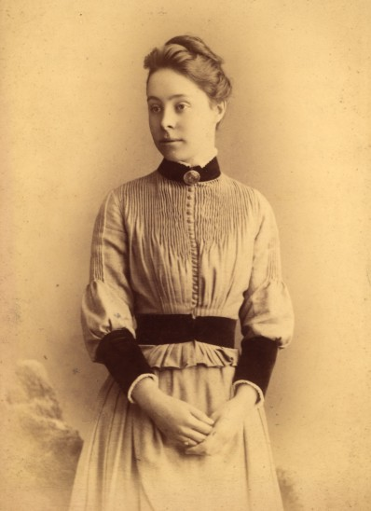
Phillipa Fawcett, daughter of Millicent Fawcett, became the first woman to beat the men at Mathematics at Newnham College but women were not ‘rated’ until 1992. (??)

Slide 21
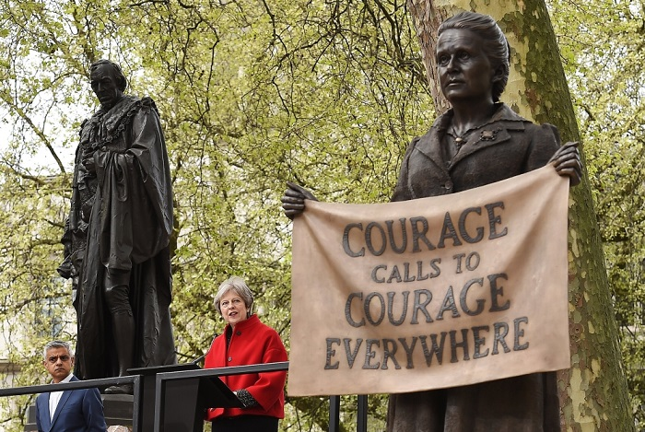

Slide 22
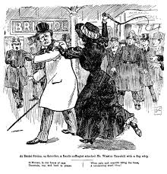

Slide 23
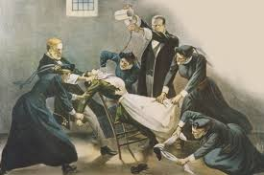

Slide 24
‘E. wind, damp & cold. Went with C to a Suffragist meeting afternoon. Digby crammed. Came out after Lady F. Balfour’s speech which was quite rational.’ (Henry Robinson King, Sherborne Schoolmaster)
(Western Gazette, February 1909)

Slide 25
The guest speaker, Alexander Maconachie MA, was asked what he thought about the force-feeding of suffragettes in prison. He answered that he did not think he would forcibly feed the suffragettes, instead he would put the food beside them and leave them to make their choice, and if they insisted on dying he would let them die. He added that he had a great faith in the aromatic odour of steak and onions at the psychological moment.

Slide 26
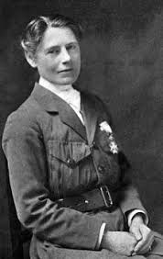
Evelina Haverfield (1867-1920)

Slide 27
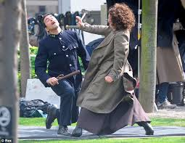

Slide 28
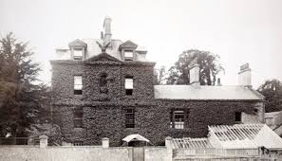
Eagle House, Batheaston, 1904

Slide 29
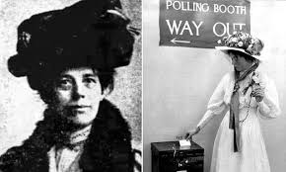

Slide 30
Diana Ruth Wilson 1886-1969
Gifted botanical artist, born in Sherborne.
‘She also rode out with the Blackmore Vale Hunt, scandalising the more conventional by sitting astride rather than side-saddle as was proper for women at the time.’
Notes:
Formerly the town’s major coaching inn, The Angel at Greenhill in Sherborne was acquired in 1865 as a boarding house by Sherborne School. It was re-named ‘The Green’ and its stables turned into senior study rooms. Stripped of its Virginia creeper, the building exists today as private apartments, its 18th-century west front approached by a flight of steps leading to a Tuscan porch.
It was here that Thomas Ward Wilson, son of a Lincolnshire clergyman, was housemaster for 25 years

Slide 31
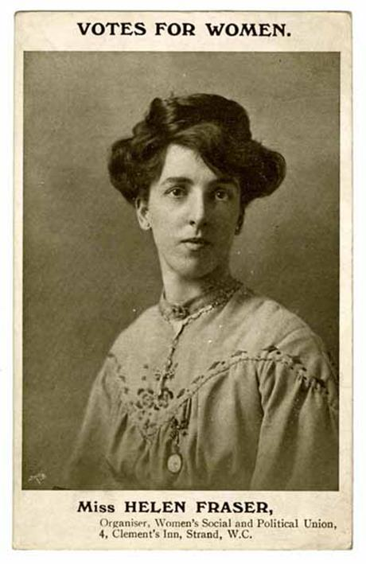

Slide 32
Village Activism!
Western Gazette, August 1913: ‘An open-air meeting was held near the Weighbridge to advocate the claims of women’s suffrage. A large gathering assembled and addresses were delivered by Mr H L Bowden, who presided, and Mrs Walter-Smith, of the National Union for Women’s Suffrage (non-militant). With the exception of a little good-natured heckling, which called forth some swift retorts, the meeting was orderly and the speakers received a good hearing.’
Notes:
Draw attention to ‘claims’ – male reporter? Wonder whether a woman reporting this would have called it ‘good-natured heckling’…? What was Bowden’s role here? What can we infer from this about the interest of women in MP in women’s suffrage?

Slide 33
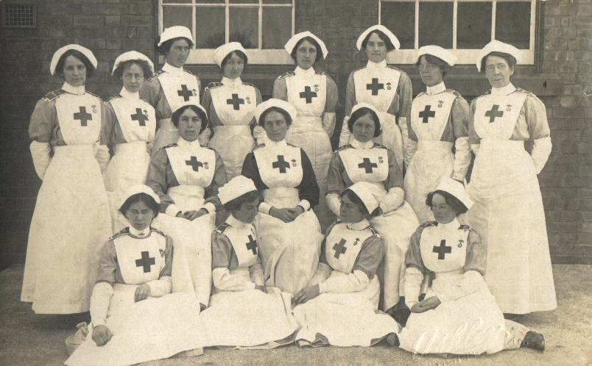
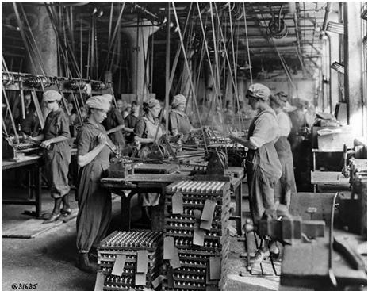
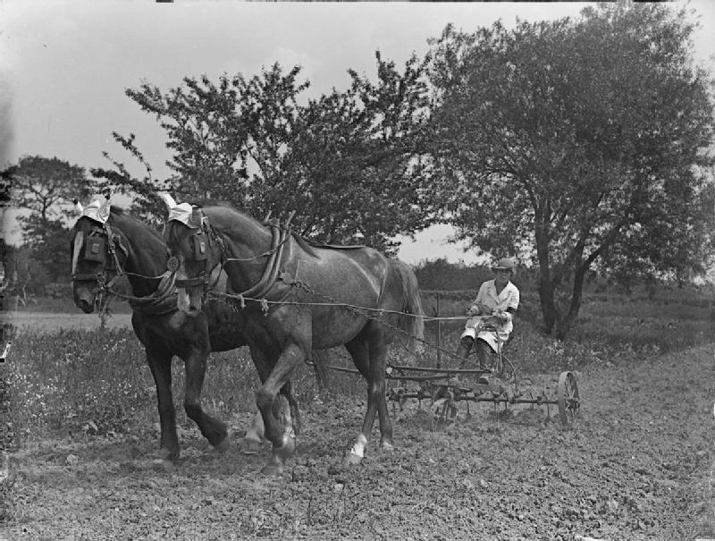

Slide 34
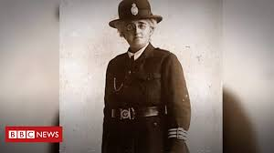
Edith Smith - 1915

Slide 36
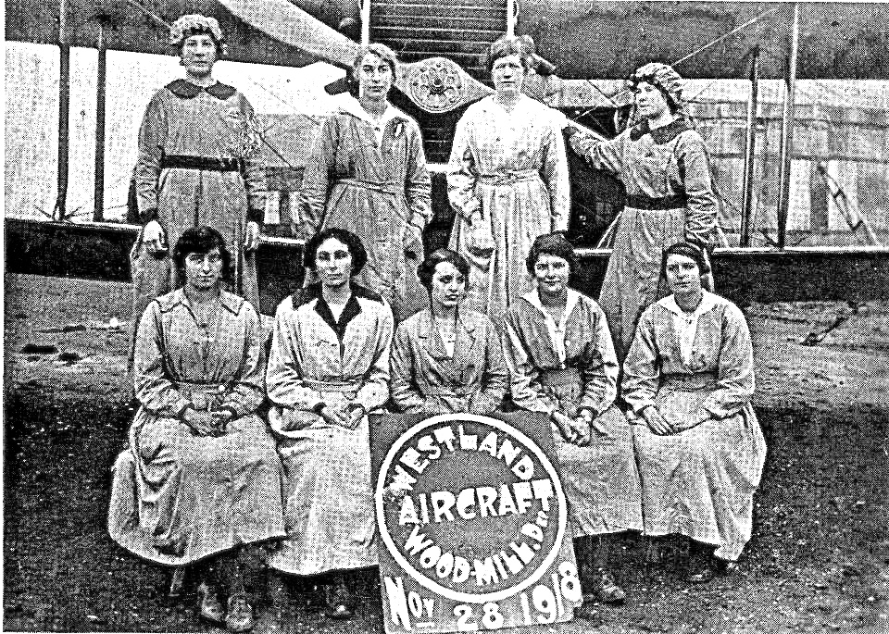

Slide 37
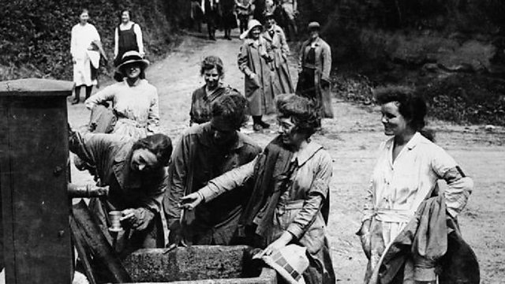

Slide 38
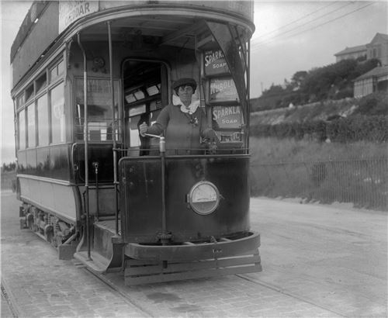
Beatrice Page - 1916

Slide 39
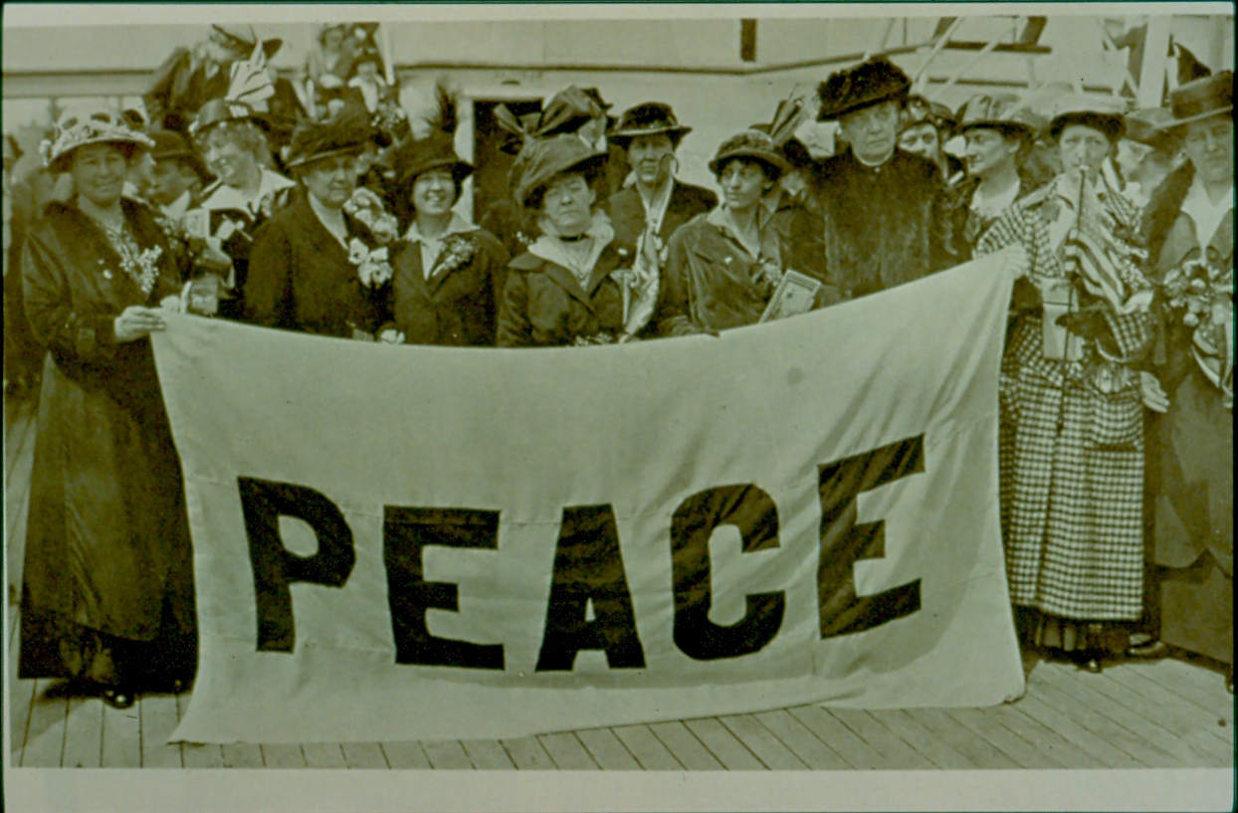
The Women's International League for Peace and Freedom held a
meeting in The Hague in March 1915 suggesting that women were the
‘Future of the World,’ with an address being given by Mrs Clothier of
Street in Somerset.

Slide 40
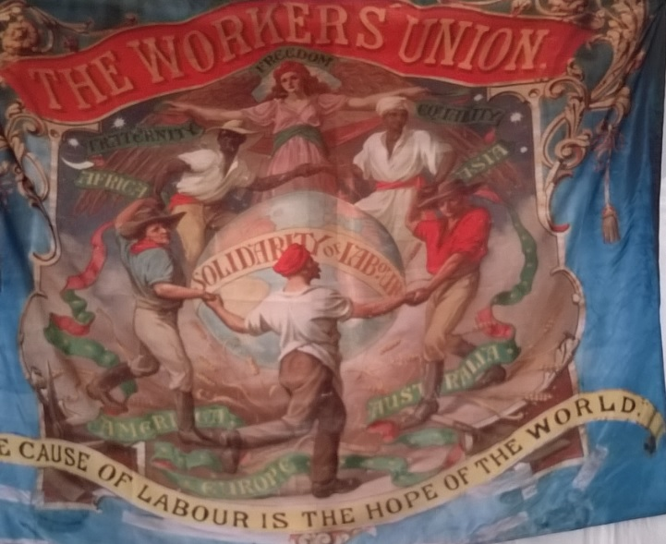
Ruby Part

Slide 41
Evelina Haverfield 1867-1920

Slide 42
Representation of the People: Fourth Reform Act
1918 – right to vote for a member of parliament for men over 21, whether or not they owned property, and to women aged 30 or over who over who resided in the constituency or occupied land or premises with a rateable value above £5, or whose husbands did.

Slide 43
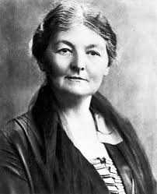
Margaret Bondfield 1873-1953
June 1925 saw a demonstration at Milborne Port by the Somerset Labour Women. Margaret Bondfield, born in Chard, was the principle speaker and had been Parliamentary Secretary to the Ministry of Labour for the short lived Labour government. She was also a women’s rights campaigner.

Slide 44
Representation of the People: Fourth and Fifth Reform Acts
1918 – right to vote for a member of parliament for men over 21, whether or not they owned property, and to women aged 30 or over who over who resided in the constituency or occupied land or premises with a rateable value above £5, or whose husbands did.
1928 – right to vote for a member of parliament for all women over 21 years old, regardless of property ownership. The Act added five million more women to the electoral roll and had the effect of making women 52.7% of the electorate in the 1929 general election. (Somerton & Frome, Frederick Gould, Labour)

Slide 46
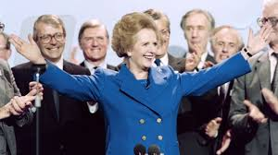

Slide 47
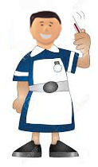

Slide 48
